Slide 1

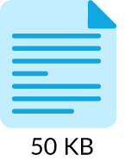

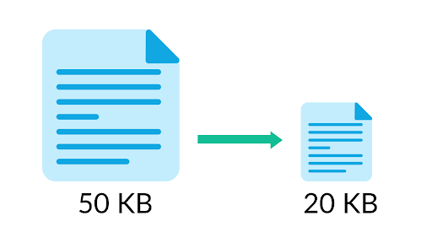
Analysis of Compression Methods for Deep Learning Networks
Madhav Sankar Krishnakumar
Parth Shettiwar​​

Slide 2
Introduction
Neural networks are both computationally intensive and memory intensive, making them difficult to deploy on embedded systems with limited hardware resources
Various compressions algorithms have emerged in recent years to make them take less space and compute
The idea is to do this without compromising much on the accuracy.
Notes:
We have an idea from earlier works. Mobile and IOT devices have smaller memory and energy requirements. So we need to have smaller models that have faster inference, without losing much on accuracy.

Slide 3
Problem statement
We present a small survey like analysis of existing in literature Compression methods for deep learning networks.
The goal is to understand the pros and cons of these approaches and their relevance in different scenarios.

Slide 4
Setup
We explore 3 prominent methods in this field:
Quantization
Pruning
Knowledge Distillation
We use the same dataset for all methods to keep the uniformity: CIFAR10 and same base model: Resnet18.
In the end, our goal would be to analyse these methods and note some takeaway messages.

Slide 5
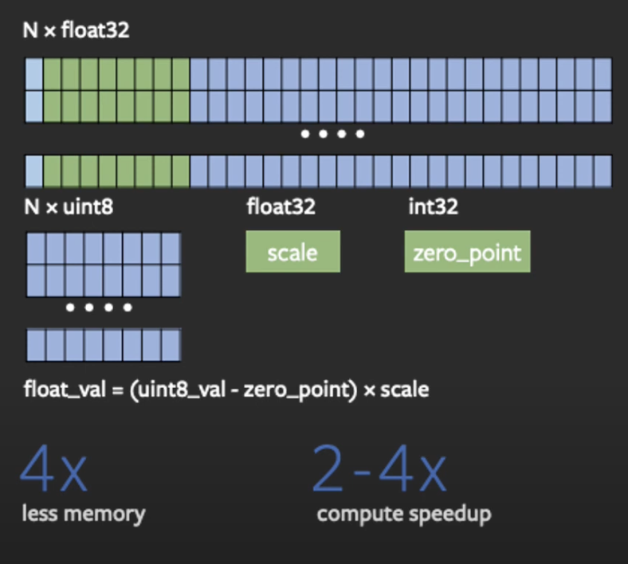
Model 1:
Quantization
1
A. Gholami, S. Kim, Z. Dong, Z. Yao, M. W. Mahoney, and K. Keutzer,
“A survey of quantization methods for efficient neural network inference,”
ArXiv, vol. abs/2103.13630, 2022
Notes:
Quantization refers to techniques for doing both computations and memory accesses with lower precision data, usually int8 compared to floating point implementations. This enables performance gains in several important areas:
4x reduction in model size;
2-4x reduction in memory bandwidth;
2-4x faster inference due to savings in memory bandwidth and faster compute with int8 arithmetic (the exact speed up varies depending on the hardware, the runtime, and the model)

Slide 6
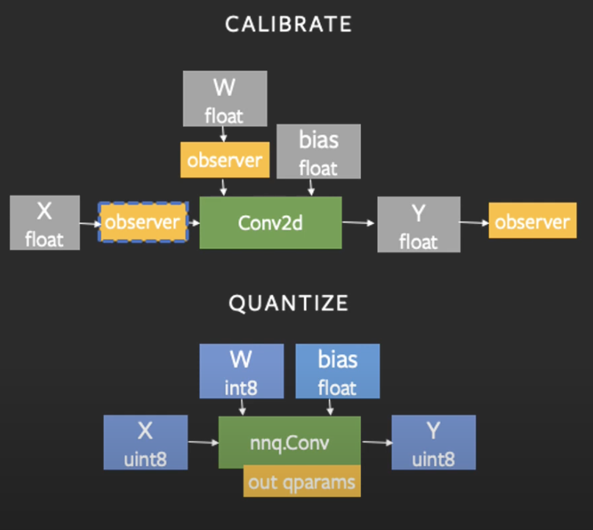
Static Quantization
Applied Post-Training.
Weights are quantized directly as we have their final values.
Calibration step takes a small portion of the training data to calibrate the zero-point and scale of the activations.
In the inference step, the quantized weights and activations are used.

Slide 7
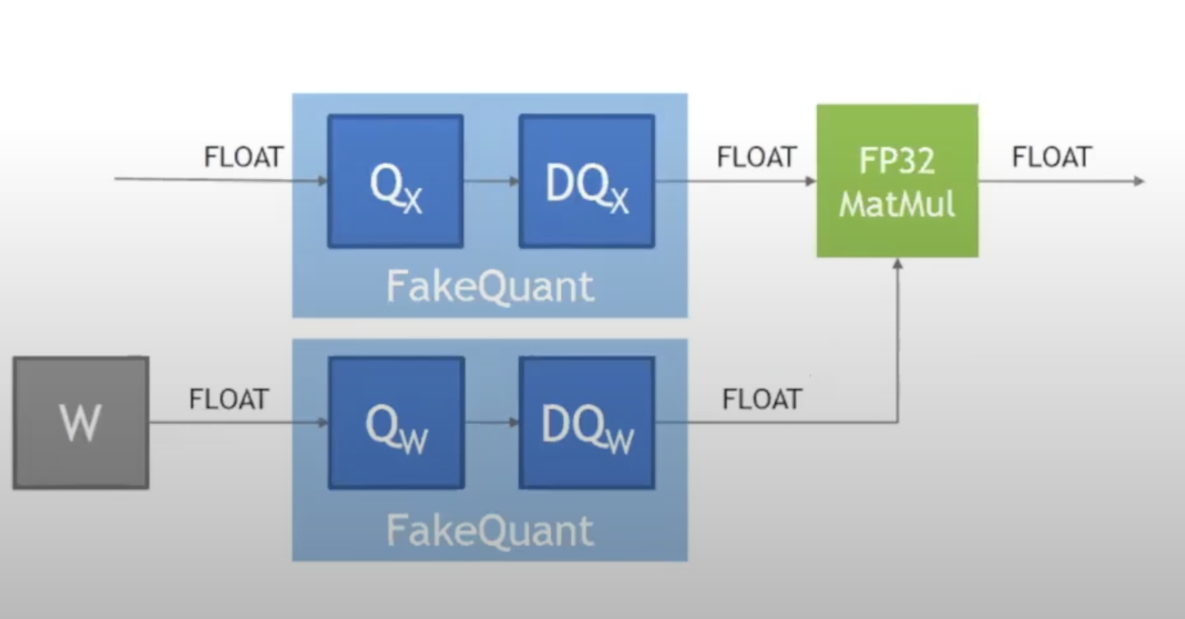
Quantization Aware Training
Fine-tune the network so that it given better accuracy for quantized data.
All weights and activations are “fake quantized” during both the forward and backward passes of training: that is, float values are rounded to mimic int8 values, but all computations are still done with floating point numbers.

Slide 8
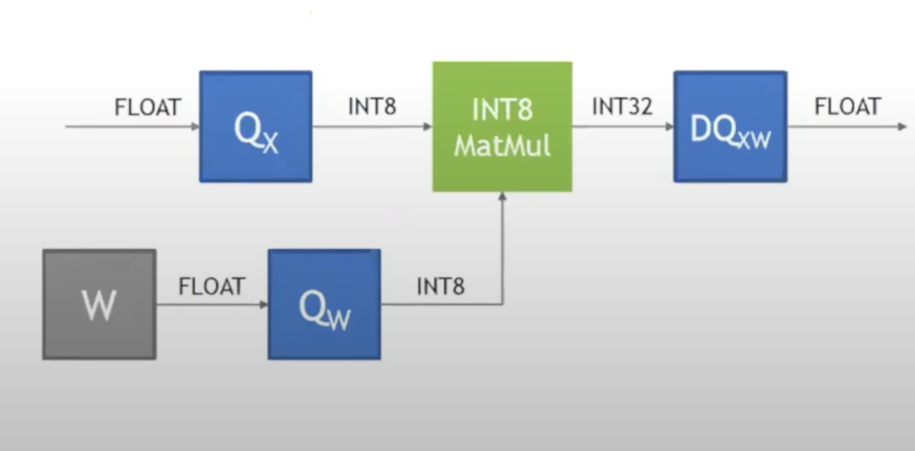
Quantization Aware Training
Fine-tune the network so that it given better accuracy for quantized data.
Inference step remains same.

Slide 9
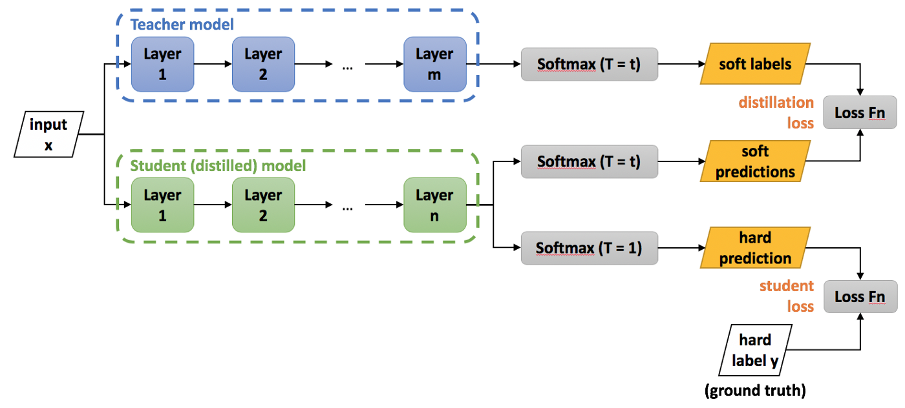
Model 2:
Knowledge Distillation
When the soft targets have high entropy, they provide much more information per training case than hard targets and much less variance in the gradient between training cases, so the small model can often be trained on much less data than the original cumbersome model while using a much higher learning rate.
Geoffrey Hinton, Oriol Vinyals, Jeff Dean
“Distilling the Knowledge in a Neural Network”

Slide 10
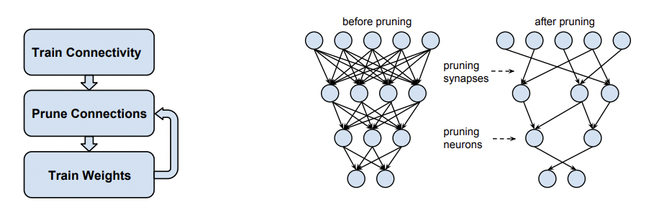
Model 3:
Pruning
First train a base network, and then recursively prune the connections based on their magnitudes and retrain until desired compression rate is reached
Magnitude based pruning
Song Han, Jeff Pool, John Tran, William J. Dally
Learning both Weights and Connections for Efficient Neural Networks

Slide 11
Quantization Evaluation:
Model | Testing Accuracy | Model size | Inference Latency
Base Resnet18 | 86.02% | 84.6MB | 18.07ms
Static Quantization | 78.8% | 24.3MB | 12.09ms
Quantization Aware Training | 84.4% | 24.13MB | 10.96ms
Notes:
2x decrease in latency and 4x decrease in model size with not much accuracy lost.
Retraining needed.

Slide 12
Knowledge distillation preliminary results
Distilled trained Resnet18 (Teacher) into smaller CNN (student) based models, and trained for 20 epochs
Model | Testing Accuracy | Model size | Number of params
Base Resnet18 | 93.02% | 84.6MB | 11173962
2 layer conv + 2 FC | 76.36% | 3.2MB | 282570
3 layer CNN + 2FC | 82.65% | 4.1MB | 357514
4 layer CNN + 2FC | 85.495 | 7.5MB | 654858

Slide 13
Pruning preliminary results
Pruned a pretrained Resnet18, based on magnitude based pruning.
Model | Testing accuracy | Model size (remove masks) | Number of params
Base Resnet18 | 90.0% | 42.6MB | 11173962
15% Pruning | 88.2% | 36.3MB | 9525629
27% Pruning | 87.4% | 31MB | 8124519

Slide 14
Takeaway message
Quantization
Needs a pre-trained network. Re-training required for QAT.
Fixed decrease in model size (~4x)
No need of designing the new model
4x decrease in model size and 2x decrease in latency without compromising on accuracy much (only 2% decrease)
Knowledge Distillation
Needs a pre-trained network
Can decrease model size based on user preference (discrete decrease: num layers)
User has to design the new model
Huge decrease in model size (about 20x), but considerable decrease in accuracy (about 8%)
Pruning
Multiple retraining has to be done in steps
Can decrease model size based on user preference (continuous decrease: pruning ratio)
No need of designing new model
1.5x decrease in model size with not much decrease in accuracy

Slide 15
Future work
Based on the observations of compression methods, we plan to merge them. As we see, the methods are serializable, and each has its pros and cons. The following pipeline can be adopted easily
Given an users industry requirements of particular model size, latency and accuracy, he can choose the appropriate num layers and prune ratio to get to desired model size without much decrease in accuracy
We will also add further takeaway messages as part of our final analysis, which will help user to get further insights in these approaches.
Knowledge Distillation for coarse decrease
(parameters: num layers)
Pruning for fine reduce (parameters: prune ratio)
Quantization

Slide 16
Questions?

Slide 17
References
G. E. Hinton, O. Vinyals, and J. Dean, “Distilling the knowledge in a neural network,” ArXiv, vol. abs/1503.02531, 2015.
S. Yun, J. Park, K. Lee, and J. Shin, “Regularizing class-wise predictions via self-knowledge distillation,” in 2020 IEEE/CVF Conference on Computer Vision and Pattern Recognition (CVPR), 2020, pp. 13 873–13 882.
Y. He, J. Lin, Z. Liu, H. Wang, L.-J. Li, and S. Han, “Amc: Automl for model compression and acceleration on mobile devices,” in Computer Vision – ECCV 2018, V. Ferrari, M. Hebert, C. Sminchisescu, and Y. Weiss, Eds. Cham: Springer International Publishing, 2018, pp. 815– 832.
S. Han, H. Mao, and W. J. Dally, “Deep compression: Compressing deep neural network with pruning, trained quantization and huffman coding,” in 4th International Conference on Learning Representations, ICLR 2016, San Juan, Puerto Rico, May 2-4, 2016, Conference Track Proceedings, Y. Bengio and Y. LeCun, Eds., 2016. [Online]. Available: http://arxiv.org/abs/1510.00149
A. Gholami, S. Kim, Z. Dong, Z. Yao, M. W. Mahoney, and K. Keutzer, “A survey of quantization methods for efficient neural network inference,” ArXiv, vol. abs/2103.13630, 2022.
S. Park*, J. Lee*, S. Mo, and J. Shin, “Lookahead: A far- sighted alternative of magnitude-based pruning,” in International Conference on Learning Representations, 2020. [Online]. Available: https://openreview.net/forum?id=ryl3ygHYDB
R. Mishra, H. P. Gupta, and T. Dutta, “A survey on deep neural network compression: Challenges, overview, and solutions,” ArXiv, vol. abs/2010.03954, 2020.

